Slide 1
Weighing supermassive black holes using tidal disruption events in Mephisto survey
Shiyan Zhong
Collaboration: Mephisto team
银河系及近邻星系多波段全色时域研究研讨会
2024-08-05

Slide 2
Outline
Introduction: using TDE to measure MBH mass
AT 2023clx observed by Mephisto
Estimation of detections for Mephisto

Slide 3
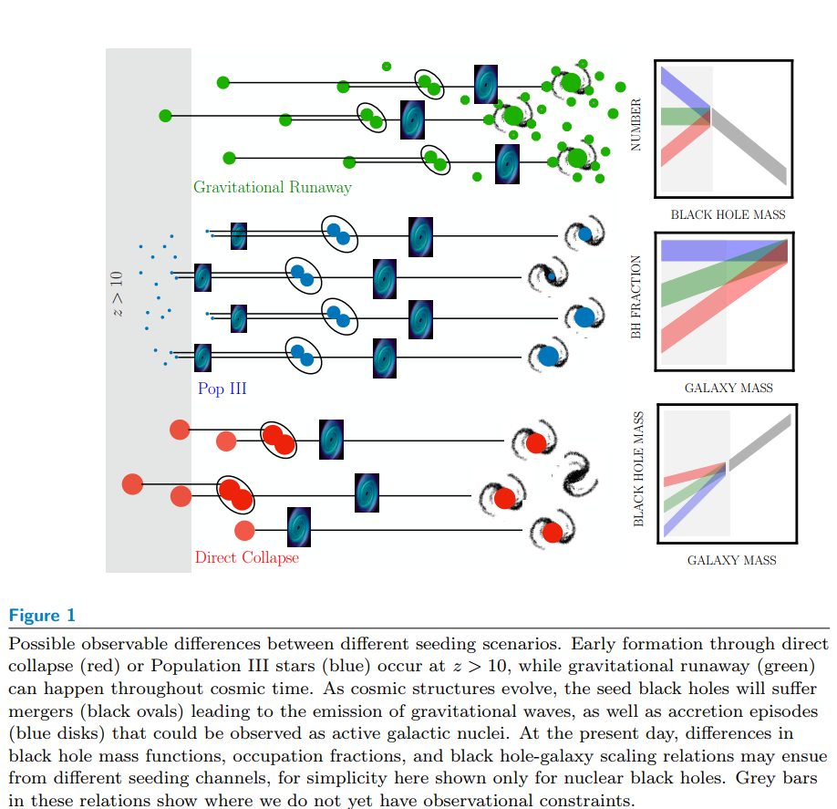
BH demographics
Greene & Ho (2019)
MBH mass function
occupation fraction
Seeding mechanisms and growth history of the MBHs.

Slide 4
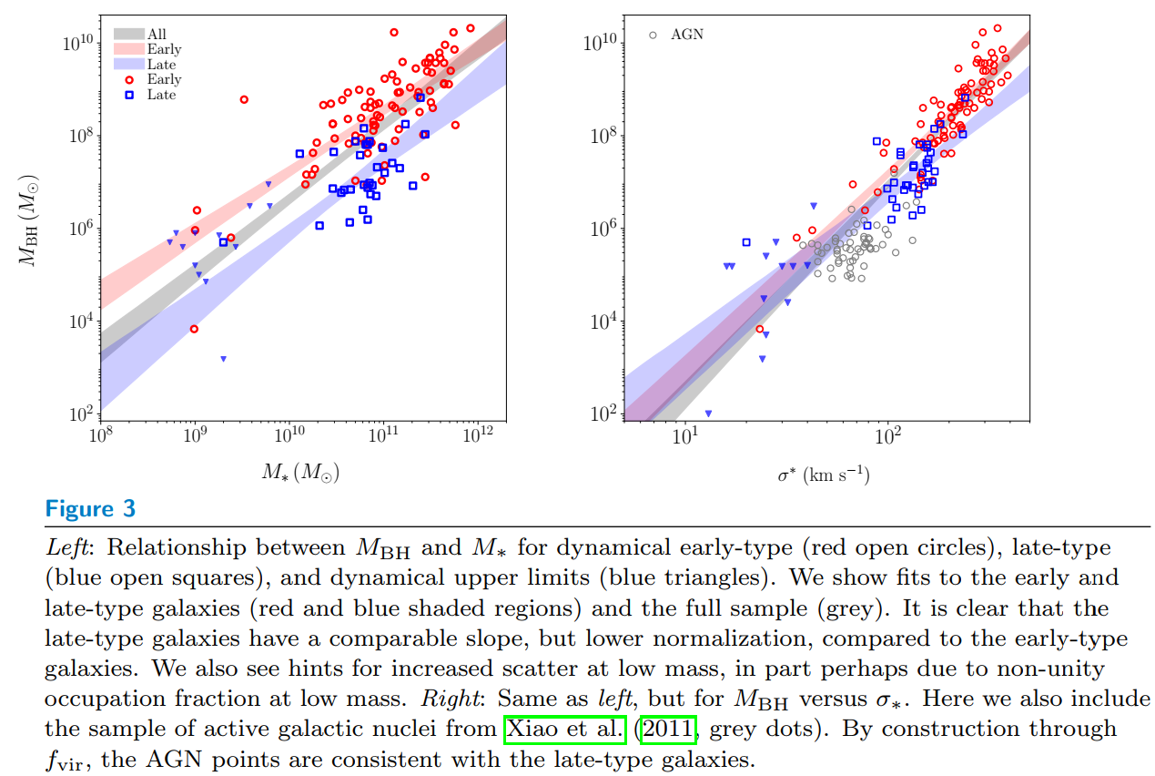
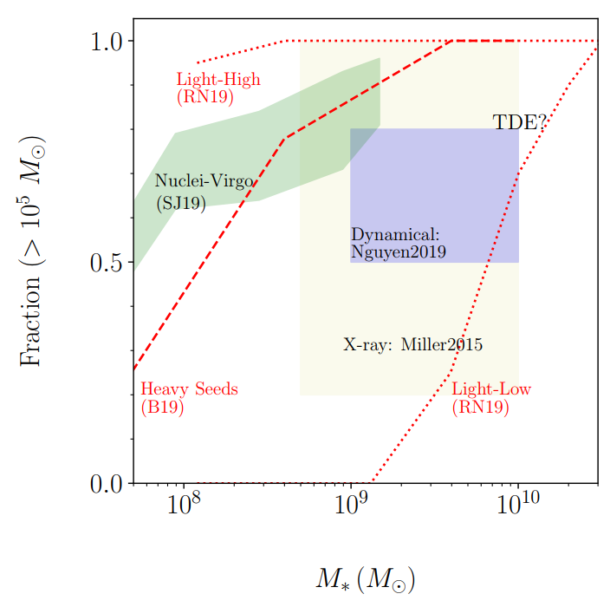
BH demographics: challenges
Low mass end (<${10}^{6}M_{⊙}$) and occupation fraction in low mass galaxies (<${10}^{10}M_{⊙}$) are poorly constrained
Most of MBH are dormant: no accretion, invisible
Detection with dynamic method: limited to nearby galaxies
Greene & Ho (2019)

Slide 5
Tidal Disruption Event (TDE)
What is TDE?
A star approaching to an MBH is torn apart and accreted, producing a luminous flare that can last for months to years.
Observation
Multi-band: X-ray, UV/Optical, IR, radio
Number of detection: more than 100, will be boosted in the coming decade
Application of TDE
Light curve: detect dormant MBH and measure its mass; study accretion physics & emission mechanism
Event rate: stellar dynamics in galactic center
http://compact-merger.astro.su.se/Movies/IMBH1000_WD02_4e6parts_P12_N.mov
Image Credit: NASA, S. Gezari, J. Guillochon

Slide 6
Tools
Physical model | Open source software | Input | Output | reference
Dynamic Blackbody Photosphere | MOSFiT | Multiband light curve | $M_{BH}$, $m_{∗}$, $β$, etc. | Mockler et al., 2019, ApJ, 872, 151
Classic Accretion Disk + Reprocessing Layer | TiDE | Multiband light curve | $M_{BH}$, $m_{∗}$, $β$, etc. | Kovács-Stermeczky & Vinkó, 2023, PASP, 135, 034102
Stream-stream collision | TDEMASS | L_{p}, T_{p} | $M_{BH}$, $m_{∗}$ | Ryu et al., 2020, ApJ, 904, 73
Eccentric Accretion Disk | -- | L_{p}, E_{rad,tot} | $M_{BH}$, $m_{∗}$ | Zhou et al., 2021, ApJ, 907, 77

Slide 7
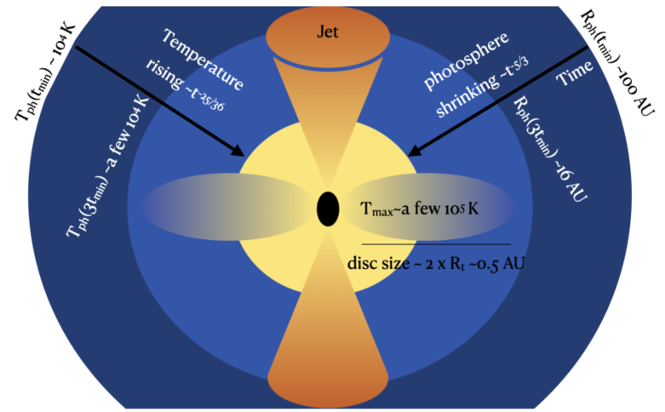
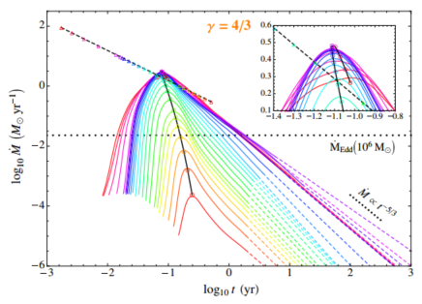
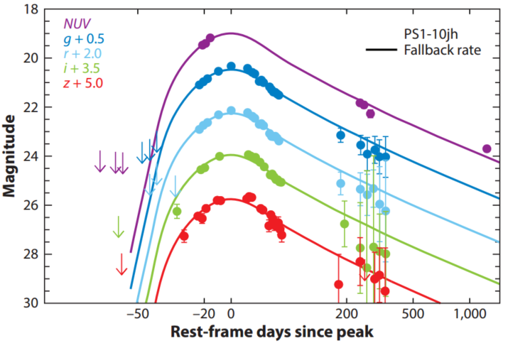
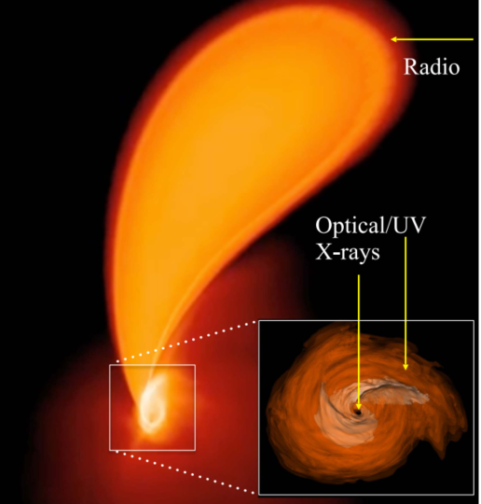
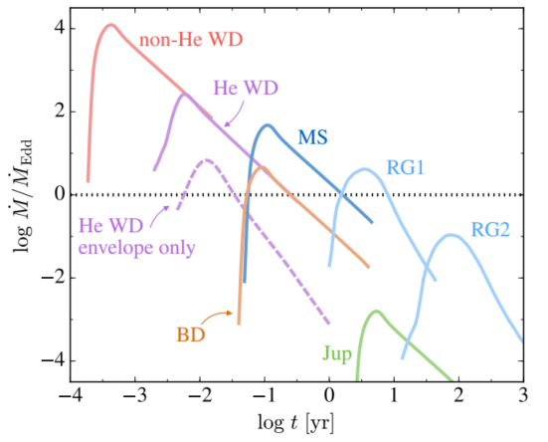
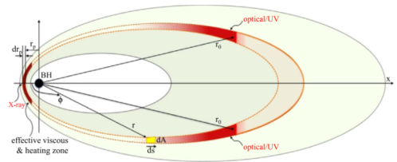
UV/Optical Light Curve Modeling procedure
Mass fall back rate
Emission model
Black hole mass
Star mass
Orbital eccentricity
Penetration factor β

Slide 8
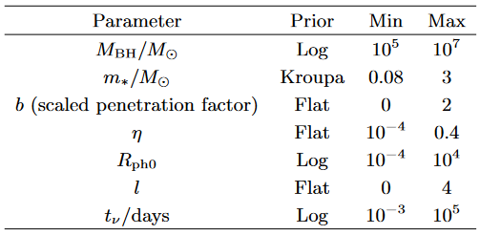
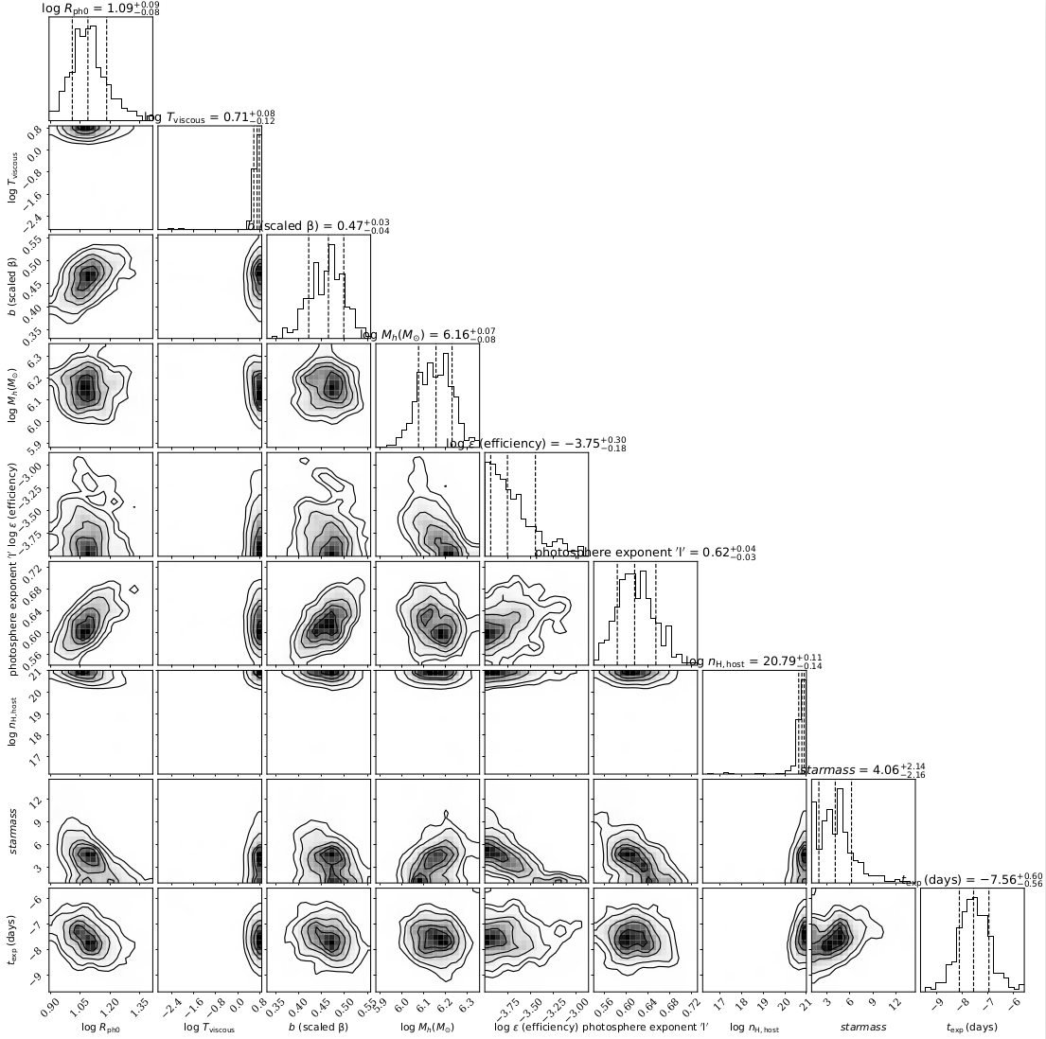
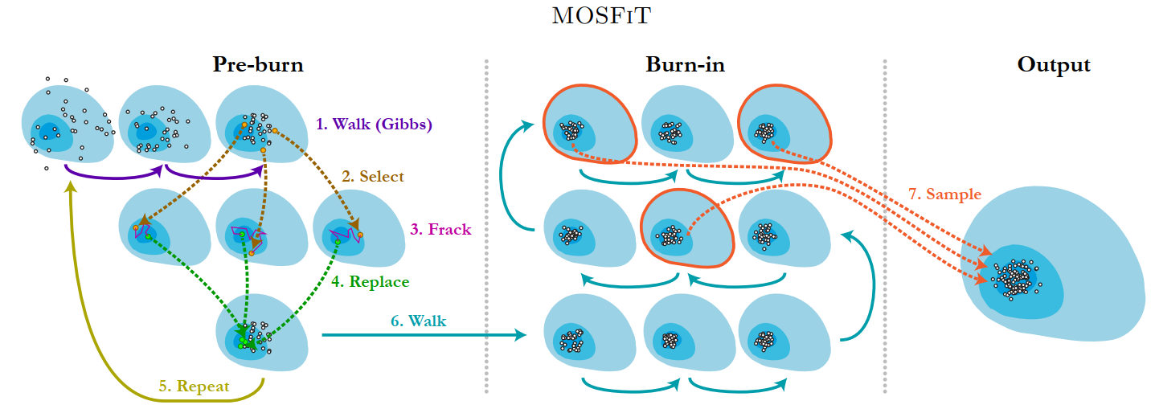
MOSFIT: Light curve fitting
Fitting parameters
MCMC fitting: obtain posterior distribution for all the parameters
Emission model: black body photosphere
and a few more…

Slide 9
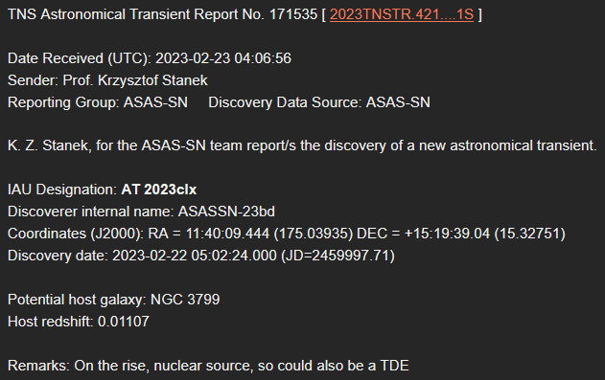
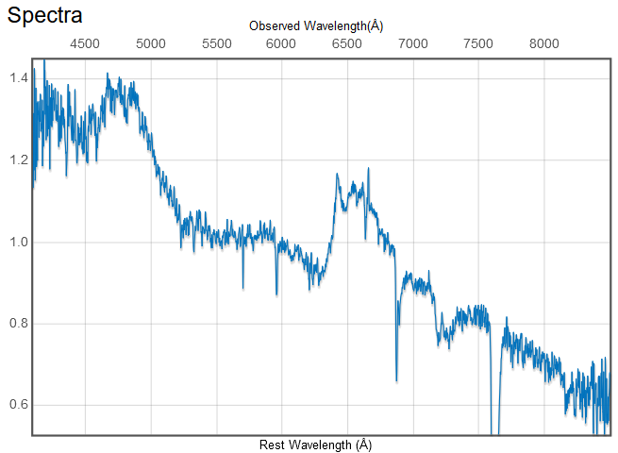
AT 2023clx (the faintest TDE to date)
Observation timeline
Feb. 23: first reported by ASAS-SN team
Feb. 26: classified as TDE, based on optical spectrum (Taguchi+2023)
Feb. 27: Mephisto started follow up observations, immediately after the installation of yellow channel camera
observed in the uvgr bands until June (rain season started)
2023-2-26
vgr synthetic color image from March 13. Created by Helong Guo

Slide 10
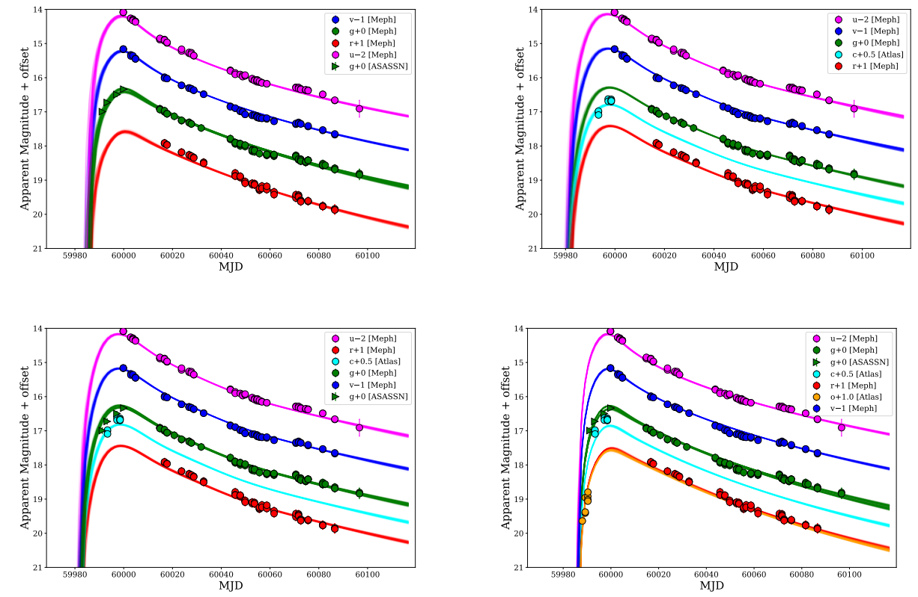
Composite light curves and fitting results
Mephisto + ASASSN g
Mephisto + ATLAS c
AS
ATc
Mephisto + ASASSN g + ATLAS c
Mephisto + ASASSN g + ATLAS c/o
AS+ATc
AS+ATco

Slide 11
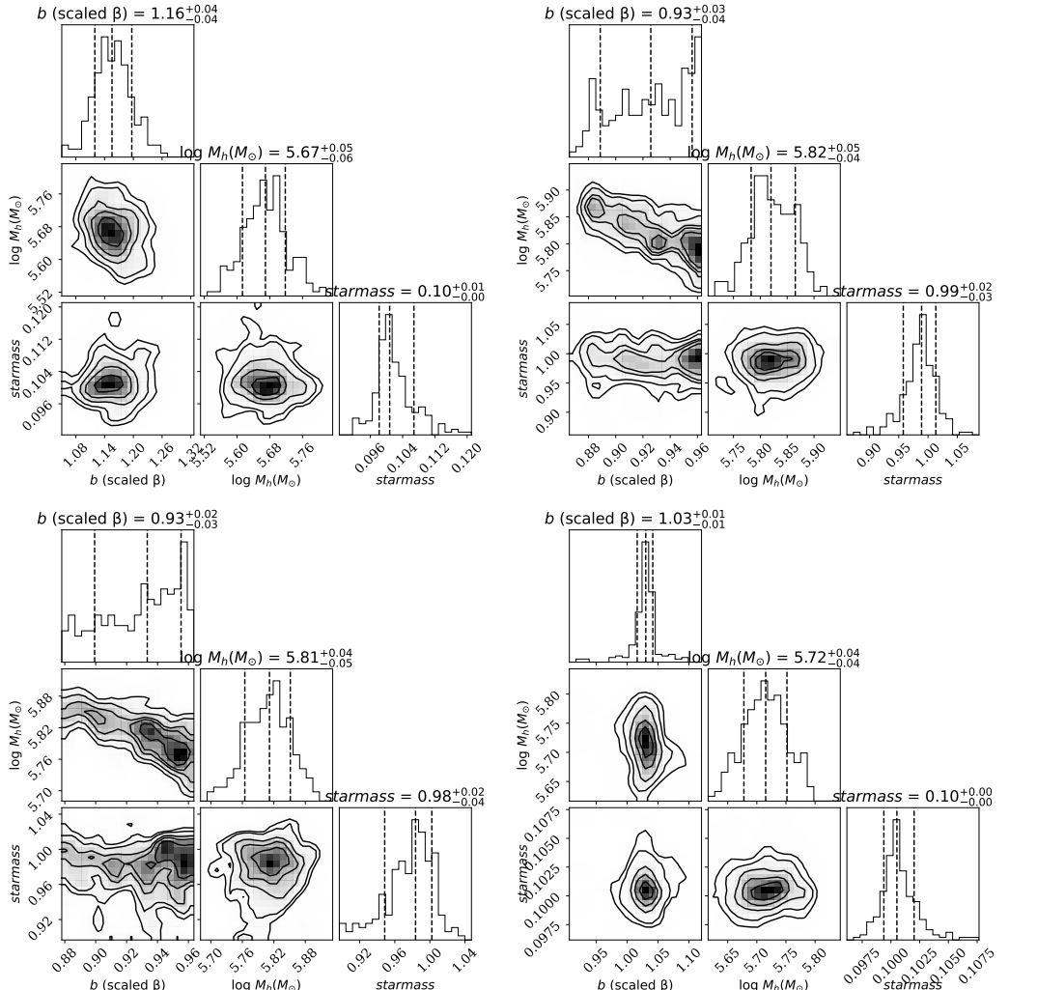
Composite light curves and fitting results
AS
ATc
Origin of AT 2023clx:
Full disruption (b>1) of a $0.1 M_{⊙}$ star
Partial disruption (b<1) of a $1 M_{⊙}$ star
AS+ATc
AS+ATco
Zhu et al. (2023): , derived from BH mass – galaxy mass relation.

Slide 12
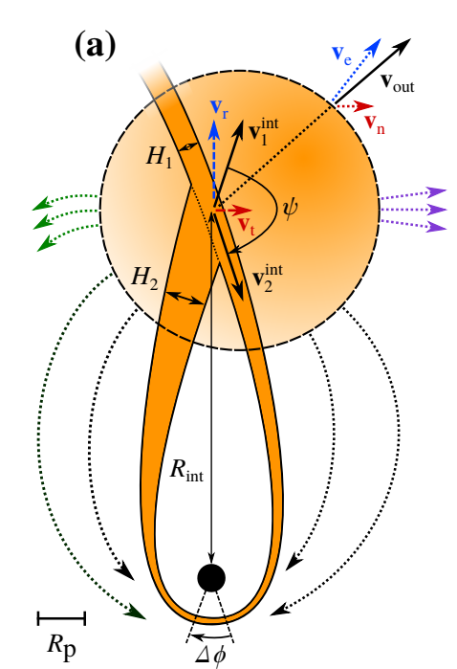
Energy source for the optical radiation
AD + RL (Roth+2020)
Emitted from reprocessing layer (RL), powered by classic accretion disk (AD)
Based on the BH mass, stellar mass and beta values
$r_{p}>10r_{g}$: apsidal precession is weak, unlikely for quick circularization and super-Eddington accretion
Radiation efficiency: all fitting models report $\log{η}$ close to $−4$, much lower than circular accretion disk (~0.1)
Powered by stream-stream collision (Piran+2015; Ryu+2023)
X-ray: non-detection between MJD 60000 – 60100 (Zhu et al. 2023)
Debris circularization is slow in AT 2023clx
We expect X-ray emerges at 100~600 days after optical peak
Future X-ray monitoring is needed
Unlikely
Stream-stream collision (Bonnerot & Stone 2020)

Slide 13
Estimation of detections for Mephisto
We select the non-AGN galaxies (z<0.4) in northern sky
Assign BH mass to each selected galaxy according to its total stellar mass
Using 5 different random seeds
Then compute the event rate for each selected galaxy
http://glade.elte.hu/
Total event number per year: ${1006}_{−30}^{+34}$

Slide 14
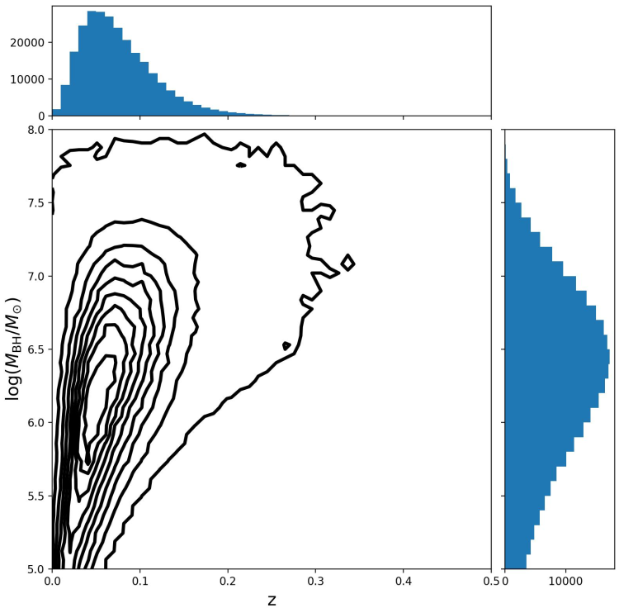
Estimation of detections for Mephisto
Detection criteria
Peak brightness in each bands are 1 mag brighter than the limiting magnitudes (30s exposure)
$u_{peak}<u_{limit,30s}−1$ and $g_{peak}<g_{limit,30s}−1$
 | Number per year
Swallowed | $${375}_{−19}^{+20}$$
Detected TDEs | $${105}_{−11}^{+10}$$
Undetected TDEs | $${527}_{−23}^{+23}$$
$$u_{limit,30s}=20.5$$
$$g_{limit,30s}=21.6$$

Slide 15
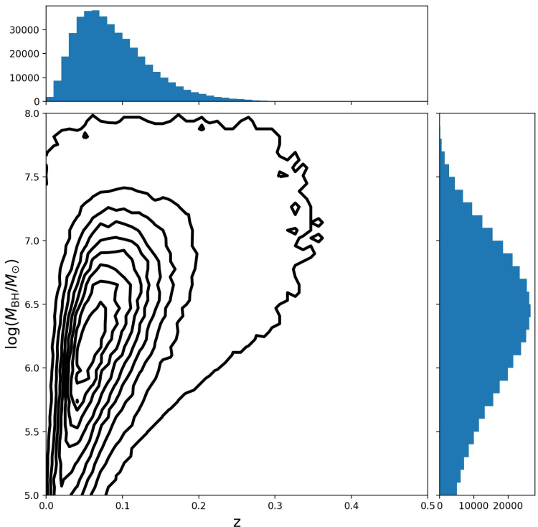
Estimation of detections for Mephisto
Detection criteria
Peak brightness in each bands are 1 mag brighter than the limiting magnitudes (30s exposure)
$v_{peak}<v_{limit,30s}−1$ and $r_{peak}<r_{limit,30s}−1$
 | Number per year
Swallowed | $${375}_{−19}^{+20}$$
Detected TDEs | $${163}_{−13}^{+13}$$
Undetected TDEs | $${469}_{−21}^{+22}$$
$v_{limit,30s}=21.$0
$$r_{limit,30s}=21.6$$
Most of the detected TDEs locate at $z<0.2$
Most distant detectable TDE can reach up to $z=0.3$

Slide 16
Summary
We have done systematic follow up observation for AT 2023clx with Mephisto
Perform independent measurement of the BH mass
The rising part of the light curve is crucial
Optical luminosity is possibly powered by stream-stream collision
We expect to detect ~100 TDEs per year
Most of the detected TDEs locate at $z<0.2$
Exploring the dormant low mass MBHs ($<{10}^{6}M_{⊙}$)
$M_{BH}$ - galaxy property scaling relation
TDE rate’s dependence on $M_{BH}$, galaxy property
vgr synthetic color image from March 13. Created by Helong Guo

