Slide 1
近邻星系多波段结构研究
李兆聿
上海交通大学
云南 丽江
2024.8.5

Slide 2
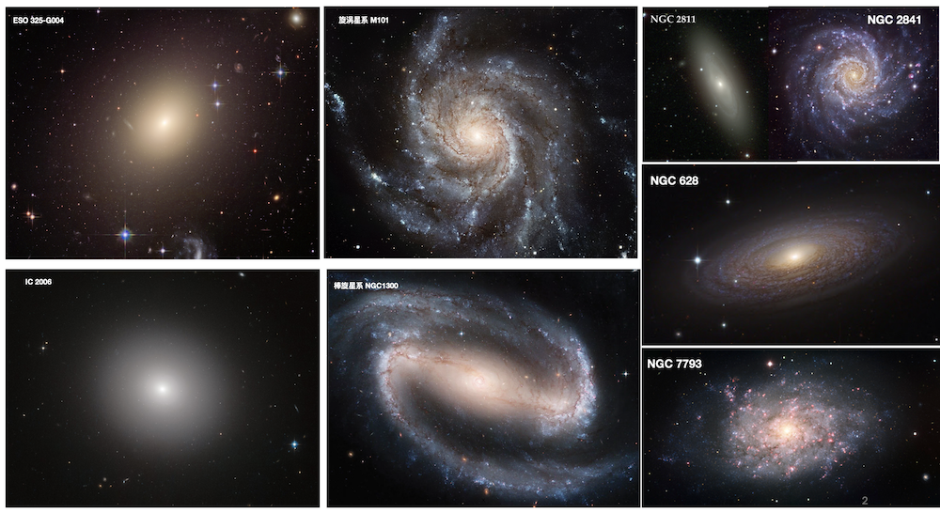

Slide 3
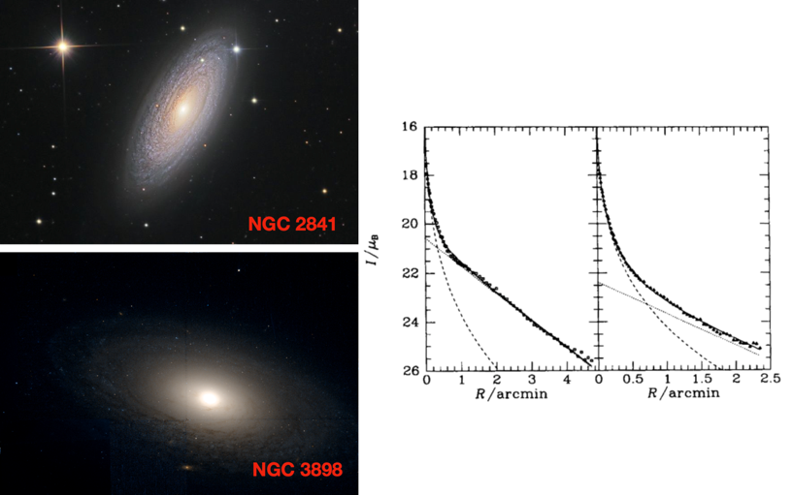
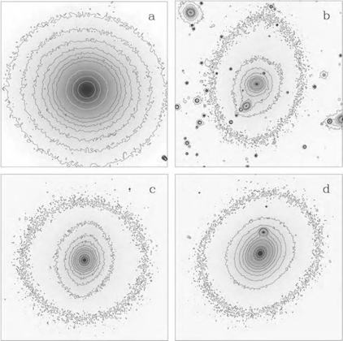
近邻星系的一维参数分析
盘星系的光度轮廓分解为核球和盘两部分的贡献

Slide 4
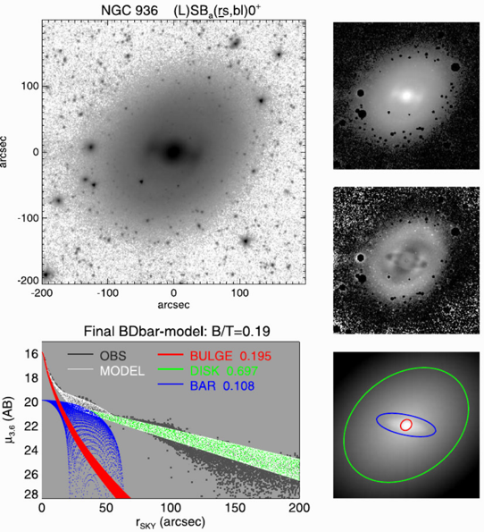
近邻星系的二维图像分解
Laurikainen et al. (2018)
通过直接建模的方法拟合星系图像
一种最简单的情况：指数盘 + 核球
2D建模的优势:
考虑等亮度椭圆随半径的变化
外部,等亮度椭圆更狭长(盘主导)
内部,等亮度椭圆更圆(核球主导)
可以从残差图中分辨出各种子结构

Slide 5
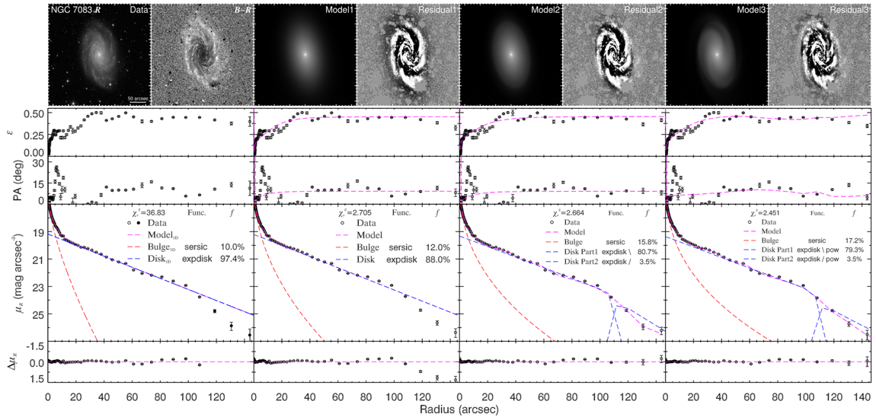
近邻星系的二维图像分解
Gao & Ho (2017)

Slide 6
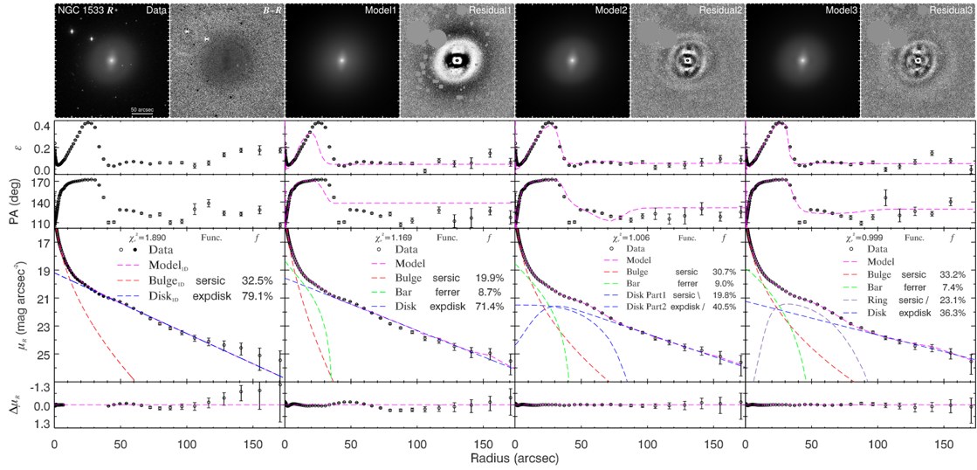
近邻星系的二维图像分解
Gao & Ho (2017)

Slide 7
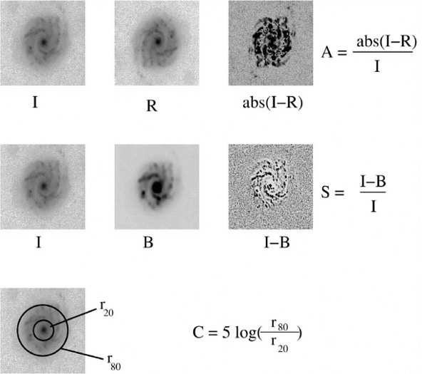
近邻星系的非参数结构测量
聚集度指数 (C, G, M₂₀)
非对称度指数 (A)
团块度指数 (S).
采用非参数化形态指数的优势:
统一量化星系形态，易于应用在大样本
基于 C−A 与 G −M₂₀ 参数空间的形态分类
Conselice et al. (2000)

Slide 8
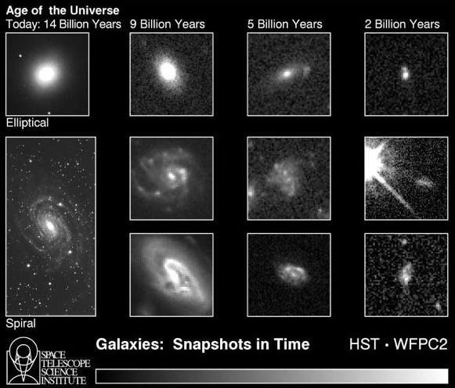
近邻星系的非参数结构测量
Conselice et al. (2000)

Slide 9
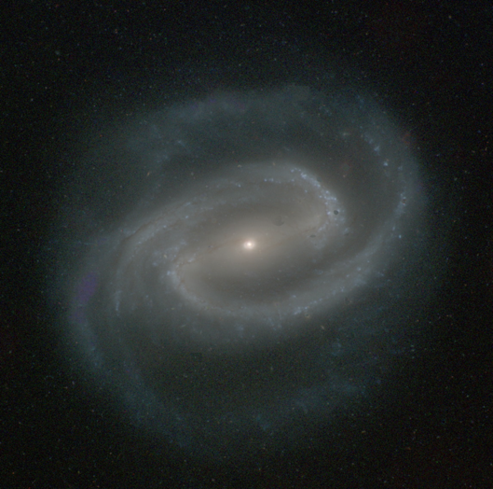
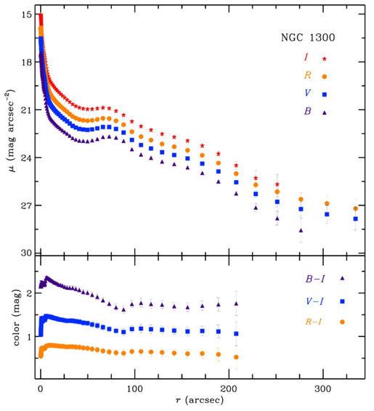
近邻星系的颜色
Ho et al. (2011)

Slide 10
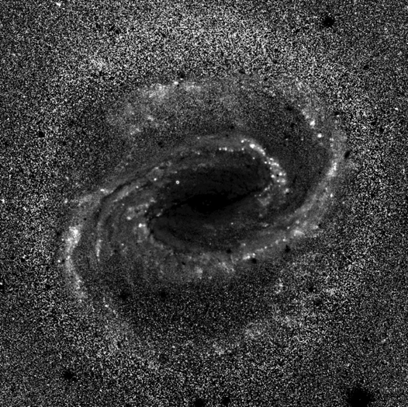
近邻星系的颜色
Ho et al. (2011)

Slide 11
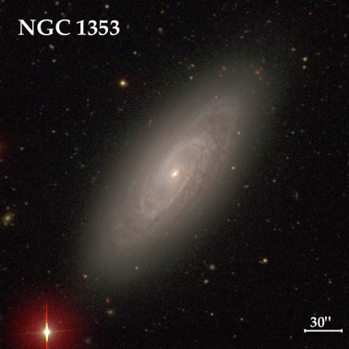
近邻星系的研究内容
盘星系中的核球性质差异
经典核球：类似于椭圆星系的亮度分布
伪核球：类似于盘的结构与运动学
Notes:
﻿S0s have a broad distribution of bulge-to-total ratios (B/T) and Sérsic indices (n), with average values of B/T = 0.34 ± 0.15 and n = 2.62 ± 1.02, qualitatively consistent with the notion that S0s define a parallel sequence with and may have evolved from spiral galaxies.
﻿However, despite their wide range of prominence, the bulges of S0s form a surprisingly uniform sequence on both the Kormendy and fundamental plane relations. There is no evidence for population dichotomy or other indications of differentiation into classical and pseudo bulges.
We conclude that late-type spirals are not plausible progenitors of S0s. The bulges of S0s likely formed at an early epoch, after which secular processes

Slide 12
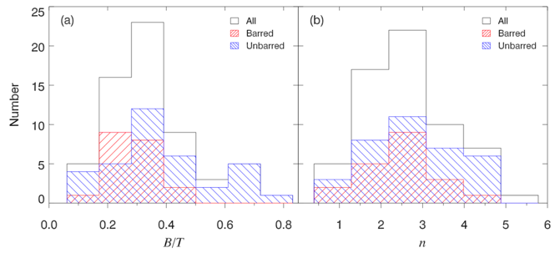
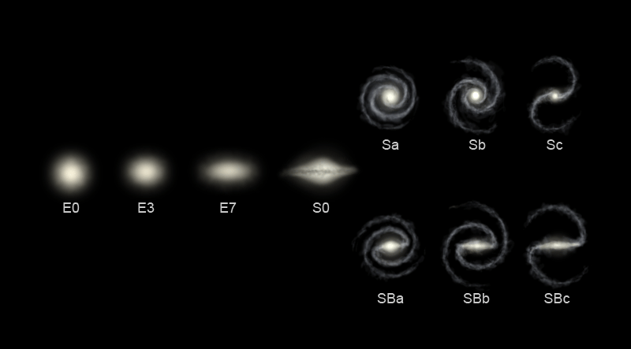
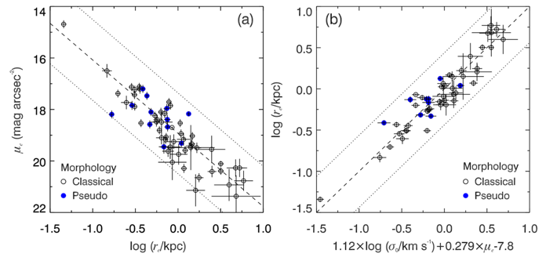
近邻星系的研究内容
Gao et al. (2018)
盘星系中的核球性质差异
S0星系的起源：来自核球的证据
与旋涡星系之间没有演化关系
Notes:
﻿S0s have a broad distribution of bulge-to-total ratios (B/T) and Sérsic indices (n), with average values of B/T = 0.34 ± 0.15 and n = 2.62 ± 1.02, qualitatively consistent with the notion that S0s define a parallel sequence with and may have evolved from spiral galaxies.
﻿However, despite their wide range of prominence, the bulges of S0s form a surprisingly uniform sequence on both the Kormendy and fundamental plane relations. There is no evidence for population dichotomy or other indications of differentiation into classical and pseudo bulges.
We conclude that late-type spirals are not plausible progenitors of S0s. The bulges of S0s likely formed at an early epoch, after which secular processes

Slide 13
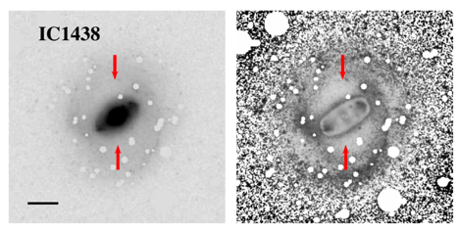
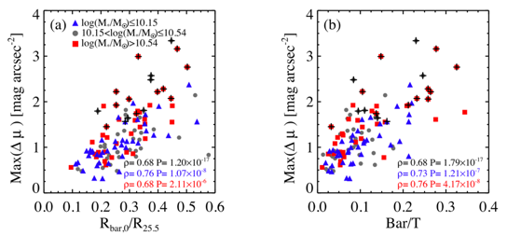
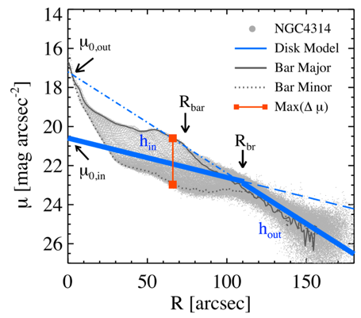
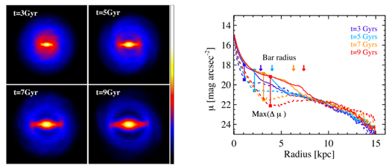
近邻星系的研究内容
棒结构的物理参数（颜色的影响）
棒在星系长期演化中的影响
有棒与无棒星系的区别
Kim et al. (2016)

Slide 14
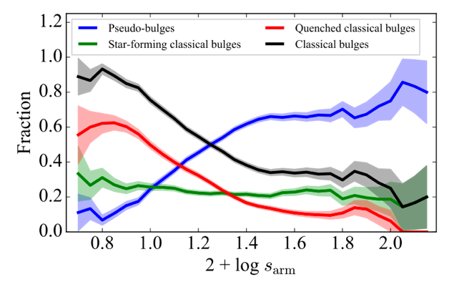
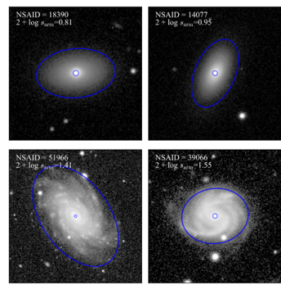
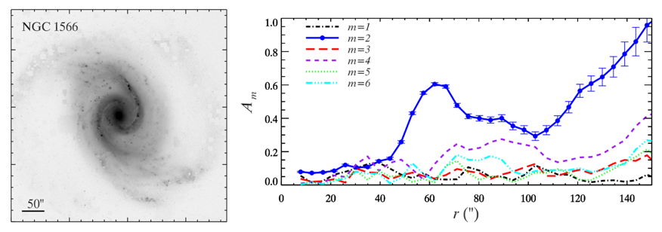
近邻星系的研究内容
旋臂结构的性质
旋臂的类型
旋臂与核球的关系
Yu et al. (2022)
Yu et al. (2021)

Slide 15
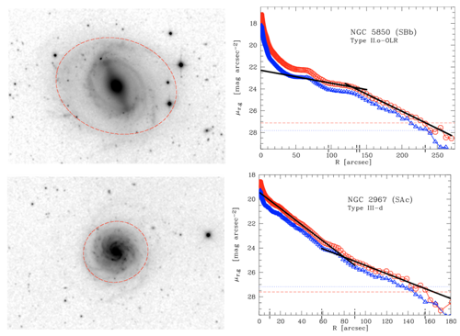
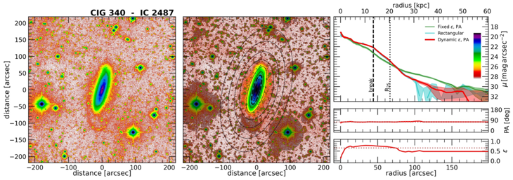
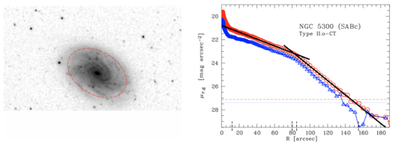
近邻星系的研究内容
Pohlen & Trujillo (2006)
盘星系的表面亮度轮廓形态分类
厚盘、恒星晕等低表面亮度结构
Sanchez-Alarcon et al. (2023)
Notes:
AMIGA sample, observed with 1) Issac Newton Telescope, 2.5 m, in Spain La Palma, 2) VLT survey telescope in Chile, 2.65 m, 3) 0.7 m JRT in California;
r-band data only
Exposure time: 5-6 hours

Slide 16
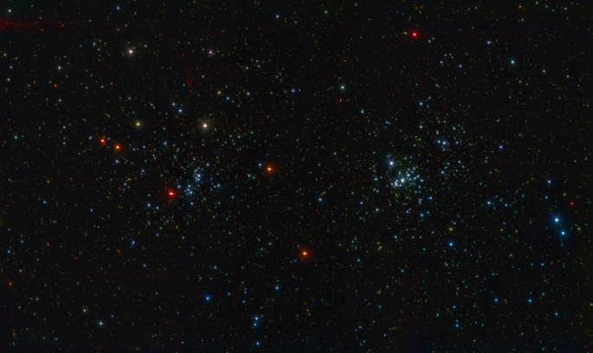
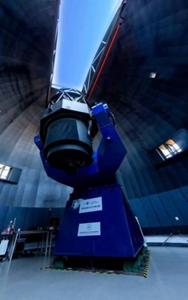
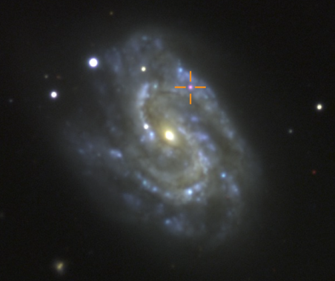
Notes:
多通道测光巡天望远镜（梦飞），是世界首台大视场、多通道高精度成像巡天望远镜，视场直径2度，配备3台超大靶面、总像素高达10亿的拼接大靶面电子耦合探测器相机，可同时在3个波段拍摄天体图像，提供天体超高精度测光及颜色信息，录制宇宙天体运动和变化的彩色纪录片。

Slide 17
